Slide 1


Deep Learning
Class 6

Slide 3
Transfer Learning
Image Classification
Object Detection
Sentiment Analysis
Machine Translation
Speech Recognition.
Medical Image Analysis.
Recommender Systems.
Improved Performance
Reduced Training Time and Resource Requirements
Handling New or Unseen Data

Slide 4
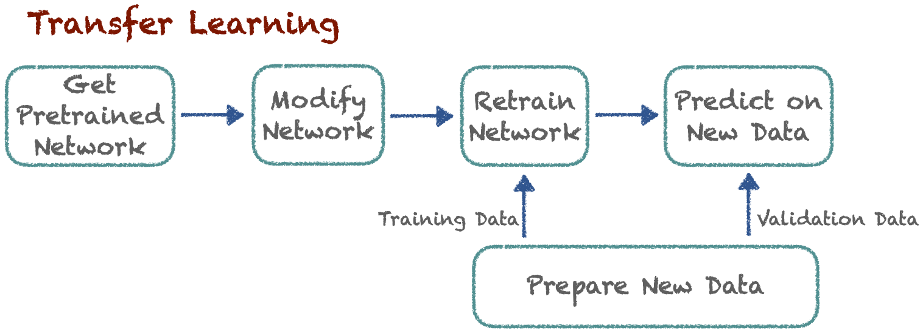

Slide 5
Transfer Learning
Pre-trained model
Feature extraction
Layer freezing
Progressive Unfreezing
Fine tuning

Slide 6
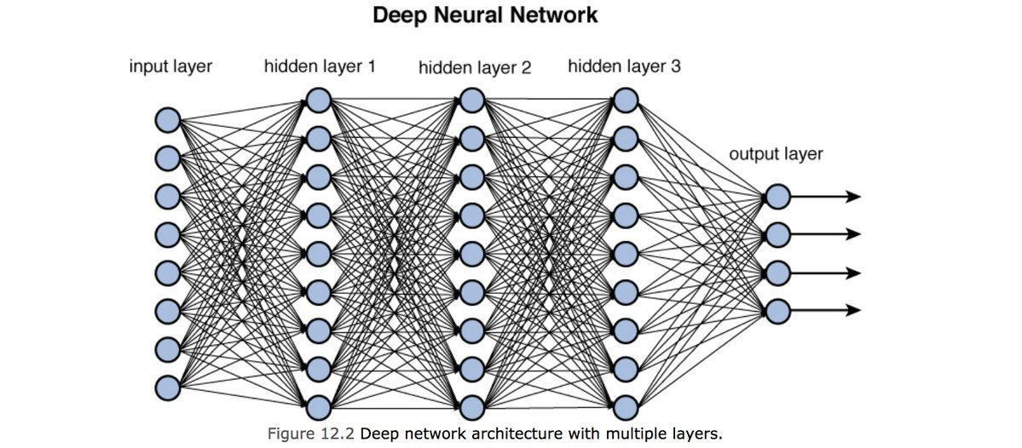

Slide 7


I drove for a while and then went to the bank to deposit my money
I swam across the river to get to the other side of the river bank

Slide 8
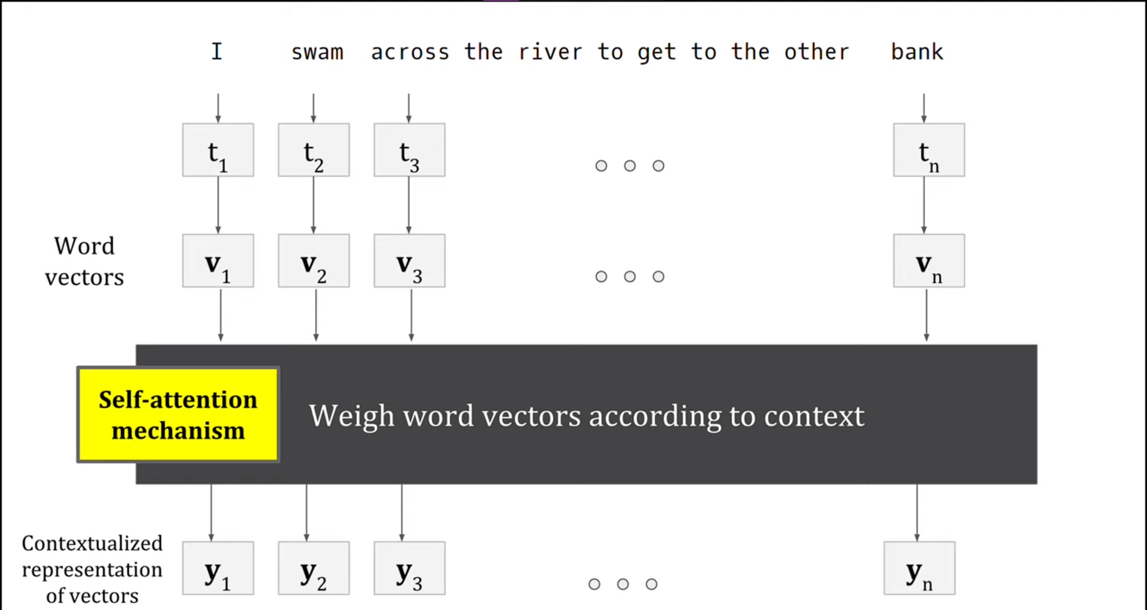

Slide 9
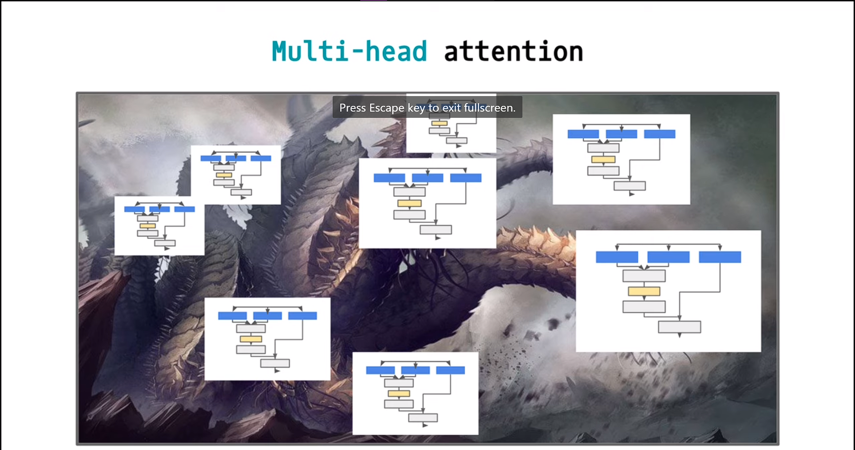

Slide 10
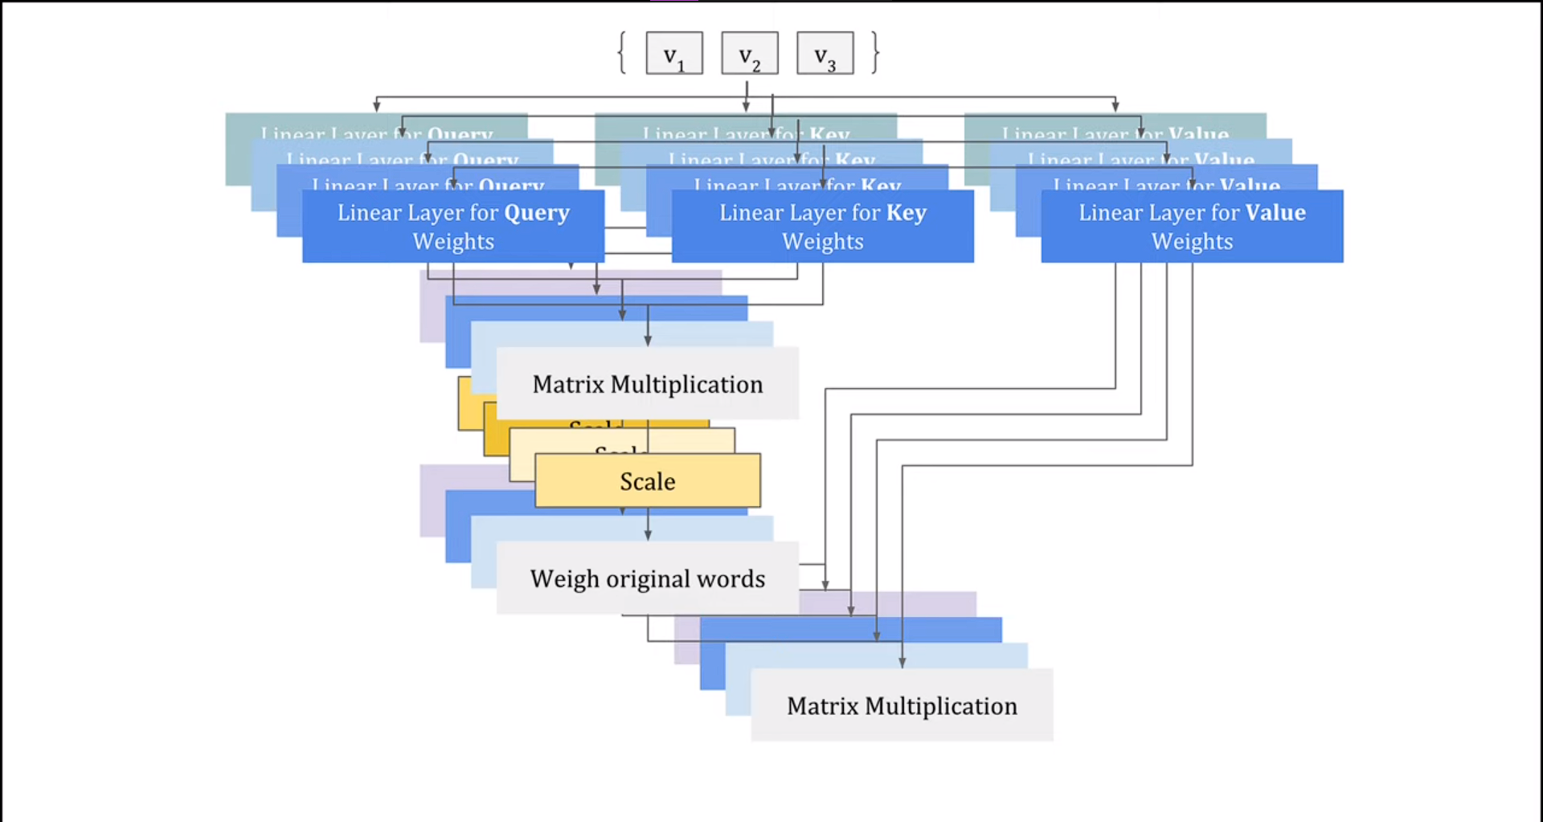

Slide 11
